Slide 1

PREDICTIVE ANALYSIS AND RATING PREDICTION USING ZOMATO DATASET
Thesis submitted in partial fulfillment of the requirements for the
Post Graduate Certificate Program in Data Science and Machine Learning
Submitted By
BALASUBRAMANYAN R.
HARSHA H.B.
KOUSHIK J.P.
MANU B B
NAVEENA
VINAY M C
Under the guidance of
PROF. AKSHATHA LAKSHMI
Notes:
Entered text
4.1 Motivation
The motivation behind this project stems from the significant impact that data-driven decision-making can have on the restaurant industry. With the growing competition and ever-evolving consumer preferences, it is crucial for restaurant owners and stakeholders to understand the factors that contribute to a restaurant's success. The extensive data available on platforms like Zomato provides a unique opportunity to analyze and predict these factors, enabling better strategic planning and operational efficiency. By leveraging machine learning techniques, this project aims to offer actionable insights that can help restaurants improve their services, enhance customer satisfaction, and ultimately achieve greater success in a competitive market.
4.2 Project Scope
The scope of this project encompasses the following key areas:
1. Data Collection and Preprocessing: Gathering the Zomato dataset and preparing it for analysis by cleaning, transforming, and normalizing the data.
2. Exploratory Data Analysis (EDA): Conducting thorough EDA to understand the data distribution, identify patterns, and highlight key features.
3. Feature Selection: Identifying the most relevant features that influence restaurant success.
4. Model Development: Building and training various machine learning models to predict restaurant success based on the selected criteria.
5. Model Evaluation: Evaluating the performance of the models using appropriate metrics to ensure accuracy and reliability.
6. Insight Generation: Analyzing the results to derive actionable insights and recommendations for restaurant owners and stakeholders.
7. Report Compilation: Documenting the entire process, findings, and conclusions in a comprehensive report.
Entered text
4.3 Project Goal
The primary goal of this project is to develop a predictive model that can accurately forecast the success of a restaurant based on various factors such as location, menu offerings, types of services, and cost for two people. Success is defined by high customer ratings and positive reviews. By achieving this goal, we aim to provide valuable insights and recommendations that can help restaurant owners and stakeholders make informed decisions to enhance their business performance.
4.4 Literature Survey
The literature for this project involves a review of existing research and studies related to predictive analytics in the restaurant industry. It includes an analysis of various factors that have been identified as critical determinants of restaurant success in previous studies.
[1] Classify Online Customer Reviews from Different Restaurants Based on Sentiment Analysis:
In this paper [1], the authors surveyed a bunch of existing research papers which explore generic rating-based recommender models as well as research papers on how the user generated reviews can be utilized as an alternative and valuable source in the recommendation process through merging them with the Multi-Criteria Recommender System(MCRS) to enhance the accuracy of the Recommender System (RS)’s performance. User-generated reviews are used to improve the accuracy of the RSs performance by using text analysis and sentiment analysis to transform the unstructured user reviews into a structured form that can be merged with RSs. Hidden elements can be extracted fromthe user’s reviews and delivering them to the RSS, tries to solve the problem of inaccurate recommendations caused by relying only on the overall ratings in the recommendation process.The major drawback of this approach is that this approach heavily depends on the the text analysis and sentiment analysis done on users’ reviews. These analytical models cannot fully comprehend or understand the user’s review, therefore utilizing only part of the review.
Entered text
[2] Efficient Hotel Rating Prediction from Reviews Using Ensemble Learning Technique:
In this research paper [2], the authors have designed a restaurant recommender system based on a novel model that captures correlations between hidden aspects in reviews and numeric ratings. The authors were motivated by the observation that a user’s preference against an item is affected by different aspects discussed in reviews. Their method first explores topic modelling to discover hidden aspects from review text. The authors use Latent Dirichlet Allocation (LDA) to create profiles for every user who has written a review. For predicting ratings for restaurants any user has not reviewed, Linear/Logistic Regression is employed. The authors use a browsing tool to select representative reviews for a particular restaurant. The model was tested on 1,168,420 reviews written by 316,702 users for 42,274 restaurants in Shanghai. Since the data available is sparse, the majority of the ratings and user profiles are estimates. Hence the accuracy achieved is a mere 50 percent.
[3] Combined sentiment score and star rating analysis of travel destination prediction based on user preference using morphological linear neural network model with correlated topic modelling approach:
In [3], multiple independent input attributes from the Zomato Restaurant data set are used to predict the rating of a restaurant. In this paper, the authors also do a comparative study between the performance of various regression models to arrive at a conclusion as to which one is best for this data set. The metrics used to measure each of the regression models are regression score, absolute error, mean squared error and root mean squared error.

Slide 2
CONTENTS:
INTRODUCTION
PROJECT DESCRIPTION
EXPLORATORY DATA ANALYSIS
DESIGN
MODELLING
KEY RESULTS
CONCLUSION
REFERENCES

Slide 3

1 INTRODUCTION
The rapid growth of the food and beverage industry
Zomato's role in the industry as a leading global food delivery company
Objective: To develop a comprehensive model for predicting restaurant success using the Zomato dataset
Key factors for analysis: Location, menu offerings, services, cost
Primary objective: Build a robust predictive model for restaurant success

Slide 4
Methodology
Steps: Data collection, preprocessing, exploratory data analysis, feature selection, model development
Machine learning algorithms for model building and evaluation
Benefits: Insights for restaurant owners and investors, informed decisions, strategic improvements
Importance of datadriven decision-making
Conclusion: Application of predictive analytics in the restaurant industry, potential of datadriven decision-making for business success

Slide 5
Motivation
Zomato provides extensive data for analysis and prediction
Data-driven decision-making can greatly impact the restaurant industry
Understanding factors that contribute to success is crucial
Machine learning can offer actionable insights for improvement

Slide 6

Project Scope
Data Collection and Preprocessing
Exploratory Data Analysis (EDA)
Feature Selection
Model Development
Model Evaluation
Insight Generation
Report Compilation

Slide 7
Project Goal
Define success by high customer ratings and positive reviews
Develop a predictive model to forecast restaurant success
Consider factors like location, menu offerings, services, and cost
Provide insights and recommendations for restaurant owners

Slide 8

Literature Survey
Review existing research on predictive analytics in the restaurant industry
Analyze critical determinants of restaurant success
Explore the use of user generated reviews in recommendation systems
Discuss the limitations of text and sentiment analysis

Slide 9
[1] Classify Online Customer Reviews from Different Restaurants Based on Sentiment Analysis
Improve recommendation system accuracy with structured user reviews
Classify online customer reviews based on sentiment analysis
Merge user-generated reviews with Multi-Criteria Recommender System (MCRS)
Address the problem of inaccurate recommendations

Slide 10
[2] Efficient Hotel Rating Prediction from Reviews Using Ensemble Learning Technique:
Recommender system based on a novel model
Captures correlations between hidden aspects in reviews and numeric ratings
Use Latent Dirichlet Allocation (LDA) to create profiles for every user
The accuracy achieved is a mere 50 percent.

Slide 11
[3] Combined sentiment score and star rating analysis of travel destination prediction based on user preference using morphological linear neural network model with correlated topic modelling approach
Comparative study between the performance of various regression models
Multiple independent input attributes from the Zomato Restaurant data set

Slide 12
[4] Improving Sentiment Classification on Restaurant Reviews Using Deep Learning Models
An approach to combine the advantages of both, collaborative filtering and knowledge based filtering
Model will choose either of the techniques based on the situation
Collaborative approach is chosen if the system knows the user well and the knowledge based approach is chosen if the user is new to the system
Drawback with this model is the computation cost and the cost to search in the user database

Slide 13
Organisation of the Report
1. Introduction: An overview of the project, its objectives, and the significance of predictive analysis in the restaurant industry.
2. Literature Survey: A review of existing research and market trends related to restaurant success factors and predictive analytics.
3. Methodology: Detailed description of the data collection, preprocessing, exploratory data analysis, feature selection, and model development processes.
4. Model Evaluation: Evaluation of the performance of the predictive models using appropriate metrics and techniques.
5. Results and Discussion: Presentation and analysis of the findings, including key insights and recommendations for restaurant owners and stakeholders.
6. Conclusion: Summary of the project, its contributions, and potential areas for future research.
7. References: A list of all the references and sources used throughout the project.

Slide 14

2 PROJECT DESCRIPTION
Business/Domain Understanding
Dynamic and competitive field
customer satisfaction and operational efficiency are key to success
consumers now have access to extensive information about restaurants
Understanding the factors that contribute to a restaurant's success

Slide 15
Project Stakeholders
Restaurant Owners and Managers: Seeking to understand the key drivers of success and improve their operations.
Investors and Financial Analysts: Looking to identify profitable investment opportunities within the restaurant industry.
Marketing and Sales Teams: Aiming to tailor their strategies based on predictive insights to attract and retain customers.
Data Scientists and Analysts: Interested in applying machine learning techniques to real-world problems within the food and beverage sector.
Customers: Indirect beneficiaries who will experience improved services and offerings based on data-driven decisions.

Slide 16
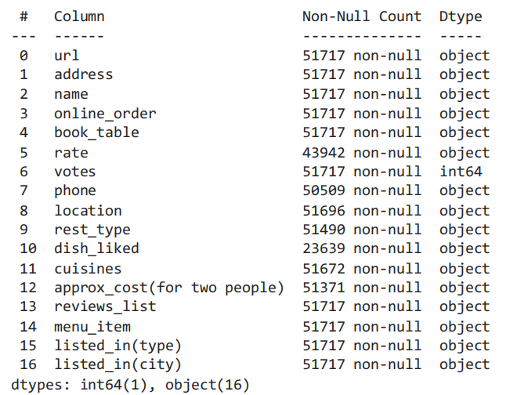
Dataset Understanding

Slide 17
Benefits of the Project
Enhanced Decision-Making: Provides restaurant owners and stakeholders with data-driven insights to make informed strategic decisions.
Improved Customer Satisfaction: Identifies key factors that contribute to positive customer experiences, enabling targeted improvements.
Investment Opportunities: Assists investors in identifying potential high-performing restaurants, optimizing investment strategies.
Operational Efficiency: Helps restaurants streamline their operations based on predictive insights, reducing costs and improving service quality.
Competitive Advantage: Empowers restaurants to stay ahead of market trends and competitors by leveraging predictive analytics.

Slide 18

3 EXPLORATORY DATA ANALYSIS
Data Collection
Dataset has been retrieved from Kaggle.
The dataset is typically obtained in CSV format
Includes various attributes such as restaurant names, locations, cuisines, menu items, customer reviews, ratings, and cost details

Slide 19
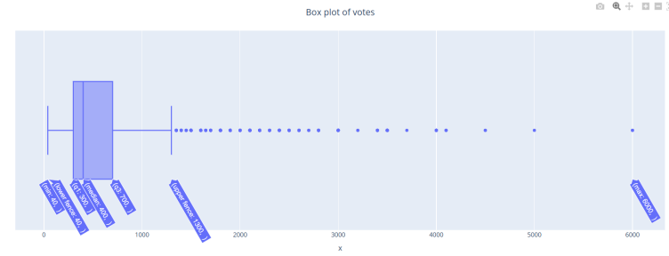
Data Cleaning
Handling Missing Values: Identifying and addressing missing data points through imputation or removal, depending on the extent and nature of the missing values.
Outlier Detection: Detecting and managing outliers that could skew the analysis, either by transforming them or excluding them from the dataset.
Consistency Checks: Ensuring data consistency by checking for and resolving discrepancies in categorical values, such as different spellings or formats for the same category.
Error Correction: Identifying and correcting any data entry errors or inaccuracies

Slide 20
Data Transformation
Encoding Categorical Variables: Converting categorical variables into numerical representations using techniques such as one-hot encoding, label encoding, or ordinal encoding.
Feature Engineering: Creating new features from existing ones to capture additional information or relationships, such as combining date and time features or extracting textual sentiments.

Slide 21
4 DESIGN
Analytical Methods and Technology Used
Machine Learning Algorithms: Supervised learning techniques such as logistic regression, decision trees, random forests, XG boost, SVC, KNN and DTC are used to predict restaurant success.
Python Programming: Python is the primary programming language utilized, along with libraries such as Pandas for data manipulation, NumPy for numerical computations, and Scikit-Learn for machine learning.
Google Colab: Used for interactive data analysis, visualization, and documentation.
Visualization Tools: Libraries such as Matplotlib, Seaborn, and Plotly are used for creating detailed visualizations.
Statistical Methods: Descriptive and inferential statistical techniques are applied to analyze and interpret the data.

Slide 22
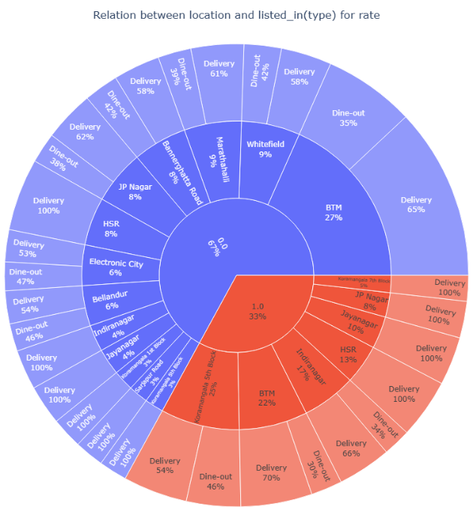
Data Visualization
Histograms and Bar Charts: For displaying the distribution of numerical and categorical variables.
Box Plots: To visualize the spread and identify outliers in numerical data.
Scatter Plots: To analyze relationships between pairs of numerical features.
Heatmaps: For visualizing correlation matrices and identifying strong relationships between variables.
Sunburst Charts: To show the composition of categorical data.

Slide 23
Feature Engineering
Encoding Categorical Variables: Converting categorical data into numerical format using techniques like one-hot encoding or label encoding.
Creating Interaction Terms: Generating new features by combining existing ones to capture complex relationships.

Slide 24
5 MODELLING
Logistic Regression: For initial baseline predictions and understanding linear relationships.
Decision Trees: For their simplicity and interpretability.
Support Vector Classification (SVC): For classification tasks with clear margins of separation.
Random Forests: For their ability to handle overfitting and capture non-linear relationships.
XG Boost (XGB): For their high predictive accuracy.

Slide 25
Evaluation and Cross Validation
K-Fold Cross-Validation: Using k-fold cross-validation to ensure the model performs consistently across different subsets of the data.
Evaluation Metrics: The evaluation of classification models involves the use of metrics such as accuracy, precision, recall, F1-score, and ROC-AUC. For this project, accuracy is deemed the most suitable metric to determine the optimal model.
The XGBoost model demonstrated a more balanced performance with an accuracy of 0.879 on the training data and 0.812 on the test data.

Slide 26
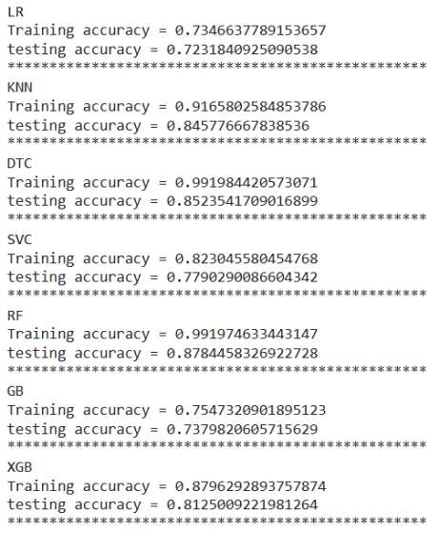

Slide 27
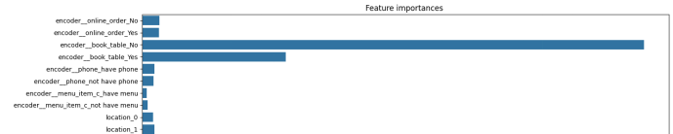
Model Interpretation
Feature Importance: Analyzing the importance of each feature in the prediction process.

Slide 28
What Worked/What Didn’t Work
Worked:
Random Forests and XG Boost: Provided high accuracy and handled non-linear relationships well.
Feature Engineering: Improved model performance by creating new, informative features.
Cross-Validation: Ensured robust and reliable model evaluation.
Didn’t Work:
Logistic Regression: Struggled with non-linear relationships and complex interactions.
Overfitting: Initial models with high complexity tended to overfit, requiring regularization and parameter tuning.

Slide 29
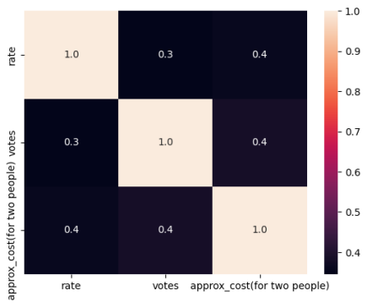
6 KEY RESULTS
Output of Intermediate Steps
Visualizations: Revealed patterns and relationships between variables, such as the correlation between cost and rating.

Slide 30
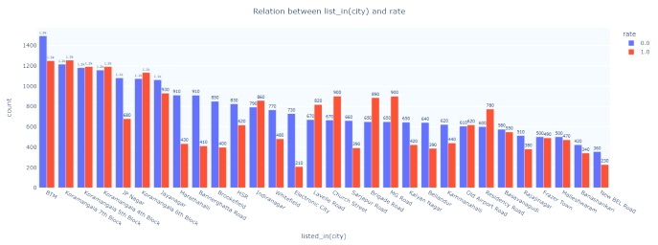

Slide 31
Feature Engineering:
Encoded Variables: Categorical variables were successfully converted into numerical formats, enabling them to be used in models.
New Features: Interaction terms and derived features were created, improving model input.
Model Evaluation:
Cross-Validation Scores: Provided insights into the consistency and robustness of the models across different subsets of the data.

Slide 32
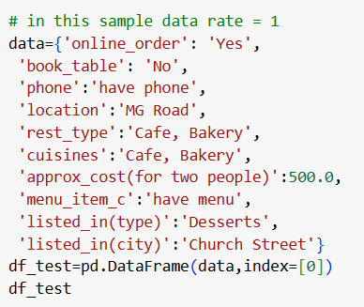
Final Outcome
Predicted Success: The model provides predictions on whether a restaurant will be successful based on input features

Slide 33
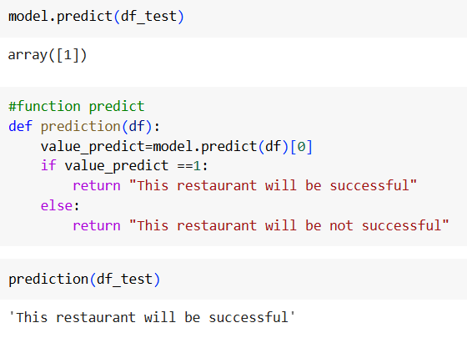

Slide 34
Analysis of the Results
Accuracy and Reliability: The model achieved high accuracy and consistency, as indicated by cross-validation and evaluation metrics, demonstrating its reliability in predicting restaurant success.
Influential Features: Feature importance analysis revealed that certain factors, such as location, cost for two, and customer ratings, have a significant impact on restaurant success. These insights can guide restaurant owners in focusing on critical areas for improvement.
Model Robustness: The use of techniques like cross-validation and hyperparameter tuning ensured that the model is robust and generalizes well to unseen data.
Business Implications: The predictive model provides valuable insights for restaurant owners and stakeholders, enabling them to make data-driven decisions. For instance, understanding that location is a crucial factor can lead to strategic decisions about where to open new restaurants.

Slide 35
7 CONCLUSION
Summary of the Project Outcome
Accurate Predictions: The final model demonstrated high accuracy and reliability in predicting restaurant success, validated through cross-validation and evaluation metrics.
Insightful Feature Analysis: Analysis of feature importance revealed critical factors such as location, cost for two, and customer ratings, which significantly influence restaurant success. These insights provide valuable guidance for restaurant owners and stakeholders.
Robust Methodology: The project employed a robust methodology, including data preprocessing, feature engineering, and the application of advanced machine learning algorithms. This ensured the model's robustness and generalizability to new data.
Practical Implications: The findings offer practical implications for the restaurant industry, enabling stakeholders to make informed, data-driven decisions to enhance their operations and strategic planning.

Slide 36
Future Work
Enhanced Feature Engineering: Further exploration and creation of new features, such as customer demographics and social media engagement, could improve the model's predictive power.
Incorporation of External Data: Integrating external datasets, such as economic indicators, local events, and competitive landscape, could provide additional context and enhance prediction accuracy.
Model Optimization: Experimenting with more advanced machine learning techniques and deep learning models could potentially yield better performance. Techniques such as ensemble learning and hyperparameter optimization could also be explored further.
Real-time Prediction: Developing a system for real-time prediction and updating the model with new data could provide continuous insights and maintain the model's relevance over time.
User-friendly Application: Creating a user-friendly interface or application to deploy the model, allowing restaurant owners and stakeholders to input their data and receive predictions easily, could increase the practical usability of the project.
Exploration of Other Domains: Applying a similar predictive analysis approach to other domains within the food and beverage industry, such as predicting the success of new menu items or marketing campaigns, could broaden the scope and impact of the research.

Slide 37
8 REFERENCES
[1] “Classify Online Customer Reviews from Different Restaurants Based on Sentiment Analysis”, Brian Zhou1, Qingyang Yang2, Lingye Kong2. Proceedings of the 3rd International Conference on Bigdata Blockchain and Economy Management, ICBBEM 2024, March 29–31, 2024, Wuhan, China.
[2] “Efficient Hotel Rating Prediction from Reviews Using Ensemble Learning Technique”, Mukesh Kumar, Chhotelal Kumar, Naween Kumar & S. Kavitha. Springer, 11 July 2024.
[3] “Combined sentiment score and star rating analysis of travel destination prediction based on user preference using morphological linear neural network model with correlated topic modelling approach”, Niranjan Kumar & Bhagyashri R. Hanji , Springer, 10 January 2024.
[4] “Improving Sentiment Classification on Restaurant Reviews Using Deep Learning Models”, Ratna Nitin Patil, Yadvendra Pratap Singh, Shitalkumar Adhar Rawandale, Sofia Singh. International Conference on Machine Learning and Data Engineering (ICMLDE 2023), 31 May 2024.

